Slide 1

Quantum 101

Slide 2
Need to Knows
Wave-Particle Duality
What are Qbits?
Quantum Measurement, Uncertainty and Decoherence
What are classical and quantum gates?
Examples

Slide 3
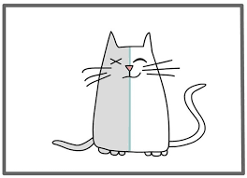
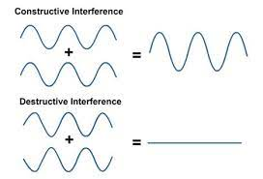


Wave Particle Duality
Quantum objects behave both as particles in some situations and waves in others. E.g. when you release an electron it travels outwards as a wave, but when it hits a wall, it will only hit in one spot (as a particle).
This duality means quantum objects can exist in a superposition of more than one state just like how many waves can be superimposed on top of one another
$$e^{−}$$
$$e^{−}$$

Slide 4
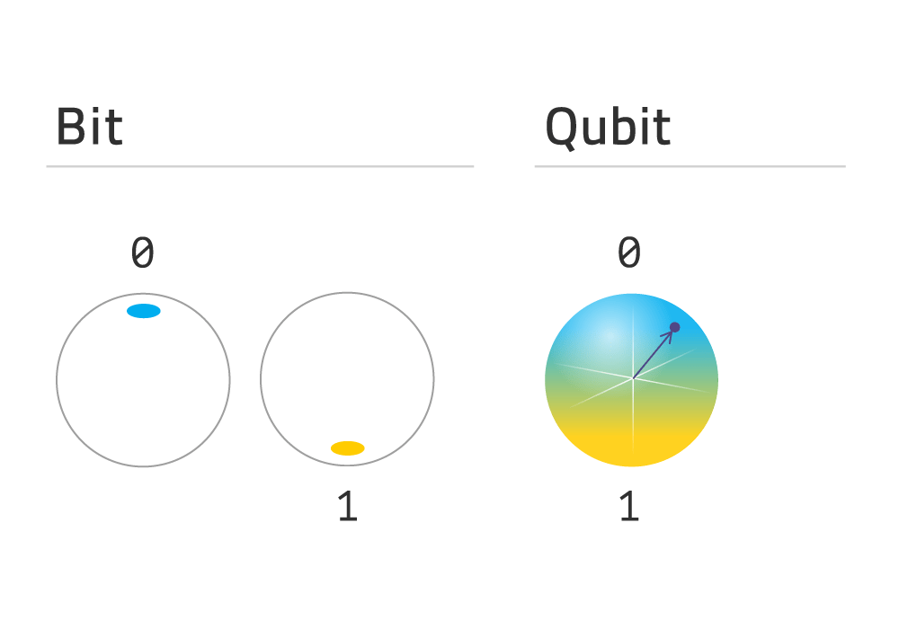
What are Qubits?
Bits (short for binary digits) are the basic unit of information in classical computing. It is a single binary value, either 0 or 1, representing a yes/no, on/off, or true/false.
Qubits (quantum bits) are the basic unit of information in quantum computing. They can represent 0 and 1 at the same time, with varying probability (in quantum superposition). This allows quantum computers to perform multiple calculations simultaneously allowing faster solutions to certain problems.

Slide 5
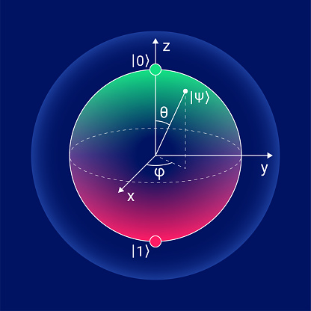
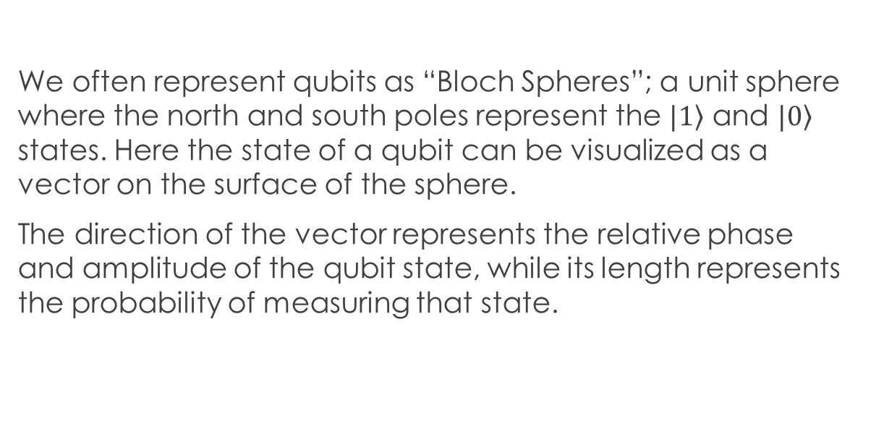
What is a Qubit (Bloch Spheres)
We often represent qubits as “Bloch Spheres”; a unit sphere where the north and south poles represent the $|\left.1\right\rangle$ and $|\left.0\right\rangle$ states. Here the state of a qubit can be visualized as a vector on the surface of the sphere.
The direction of the vector represents the relative phase and amplitude of the qubit state, while its length represents the probability of measuring that state.

Slide 6
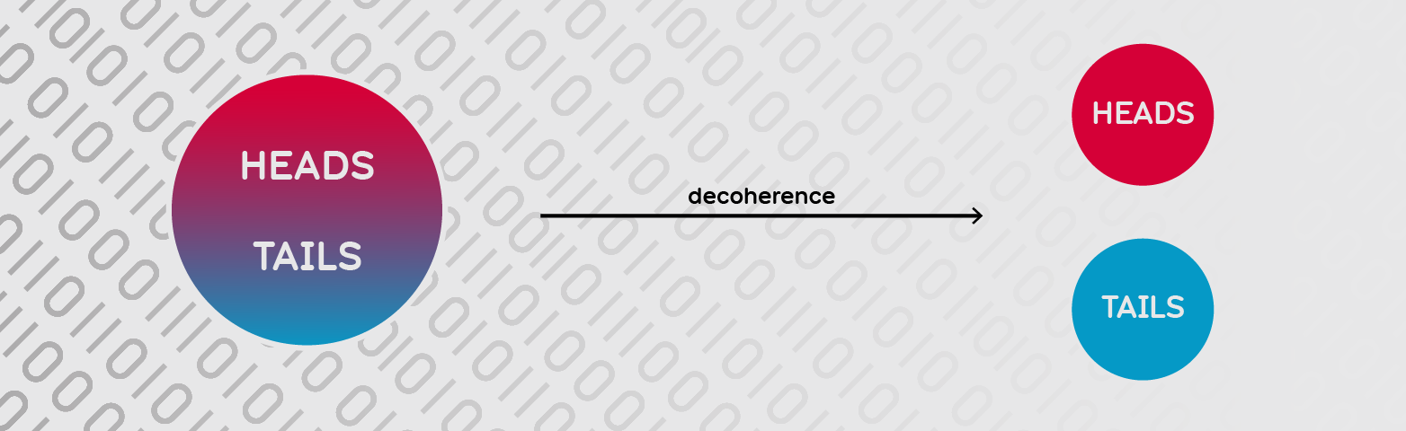
Quantum Measurement Uncertainty and Decoherence
Classically, we can measure the same object in multiple ways: If I have an apple, I can measure its colour, size and weight all at together. Measuring the colour of the apple wont change its weight.
However, in the quantum world, we can’t always measure the same object in multiple ways; for example measuring an electrons position with high precision will unavoidably change its momentum, this is the uncertainty principle.
Measurements therefore collapse our qubits superposition of many possible states into a bit with a value of either 0 or 1 (with an appropriate probability). Unwanted interactions with their surroundings can also cause this collapse.

Slide 7
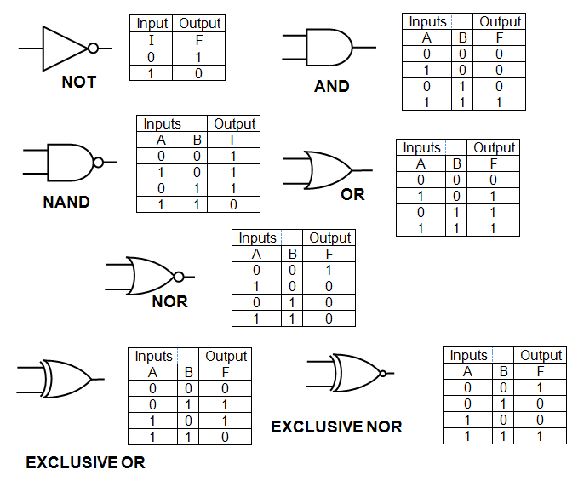
Classical Gates
Classical gates are binary operations that change the state of bits; for example a “NOT” gate will change a bit from a 1 to a 0 or a 0 to a 1.
An “AND” gate takes 2 bits as an input and outputs 1 if both bits are 1, otherwise it outputs 0.
These simple gates are the building blocks of classical circuits; the foundations of classical computing.
Everything else from video games to Artificial Intelligence is built from them.

Slide 8
Quantum Gates
Quantum gates are the basic building blocks of Quantum circuits which are the fundamental components of quantum computing. Similar to Classical gates, they manipulate the state of qubits except instead of moving between only 0 and 1 we now alter the quantum state of the qubit.
Each quantum gate corresponds to a rotation of the qubit state vector on the Bloch sphere.

Slide 9


Quantum Gates (Examples)
Possibly the most basic quantum gate, is the Pauli X gate. Analogous to the classical NOT gate, takes a single qubit and flips its state. A qubit in state $|\left.1\right\rangle$ will transform to state $|\left.0\right\rangle$
The Hadamard gate (H Gate) corresponds to a rotation of 90 degrees around an axis that is halfway between the north and south poles of the Bloch sphere. A qubit in state $|\left.1\right\rangle$ would transform to a superposition state with equal probability of being measured in state $|\left.1\right\rangle$ or $|\left.0\right\rangle$.
Many more quantum gates exist, including those that take 2 qubits as an input allowing us to build up our quantum circuits.
H Gate
X Gate

Slide 10
Example of Quantum Computers

